Slide 1
Aviation Data Analysis
Minimizing stakeholder investment risk through data analysis.
By: Andrew Reusche

Slide 2

Summary
This project uses data cleaning, feature engineering, and descriptive data analysis of the NTSB Aviation Accident Database dataset to help inform my company's stakeholders about what decisions they can make to help minimize their risk when selecting a new Jet Airplane enterprise to invest in.

Slide 3

Outline
Business problem: Select a new Jet Plane operation to invest in.
Data: NTSB Aviation Accident Database
Methods: Data Cleaning, Feature Engineering, and Analysis
Results: Region of Operation, Jet Carrying Capacity, Type of Jet Engine
Conclusions and Next Steps: Analysis conclusions and possible future analyses

Slide 4

Business Problem
My company would like to diversify its portfolio by investing in a new Jet-plane operation. Due to this being a new field for my company, my analysis will help guide the stakeholders in selecting an operation with minimized risks. This is done through my highlighting of certain aspects of Jet operations that can be controlled to help minimize the chance of a flight resulting in a fatal incident.

Slide 5
Data Used and Data Limitations
Data Used
Data Limitations
I use NTSB Aviation Accident Database dataset to conduct analyses about what factors may lead to a lower chance of a flight resulting in a fatal incident.
90,348 records of problematic flights from 1962 to 2023.
Each record gives information, across 30 columns, about the type of aircraft, date/location of incident, and incident severity for each event.
Only records of problematic flights are included, not total records of all flights.
Can only analyze attributes of problematic flights, not what causes the problems.

Slide 6

Data Analysis Methods
Data Cleaning: Filtered out all data not immediately relevant to factors our stakeholders could control when selecting a jet operation.
Feature Engineering: Use the filtered data to create new columns that help assist with analyzing which Jet operations have the lowest operating risks.
Data Analysis: Analyze the newly engineered data to determine what specific characteristics flights with lower fatality rates usually have.

Slide 7
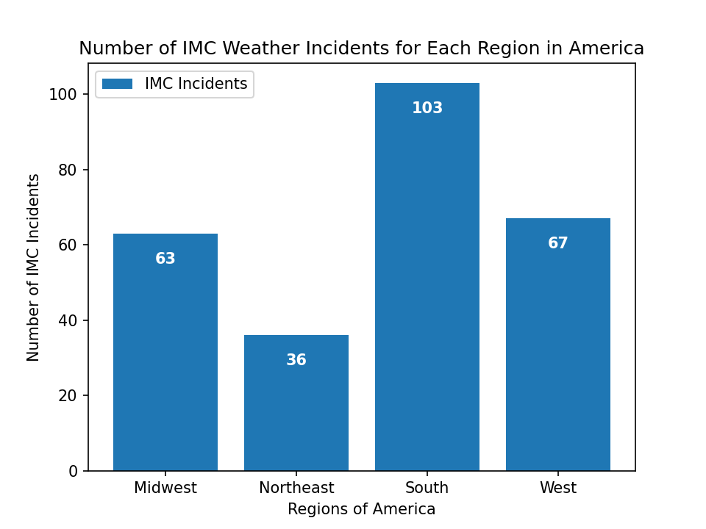
Results: Region of Operation
Flying during IMC (Instrument Meteorological Conditions) can add unwanted difficulty to flights, making them more prone to problems and incidents.
I have run an analysis to see which region of the USA experienced the fewest incidents during IMC.
The Northeast region of the USA has experienced the fewest number of flight incidents during IMC.
Northeast Region (Sates): [PA, NY, NJ, CT, RI, MA, VT, NH, ME]

Slide 8
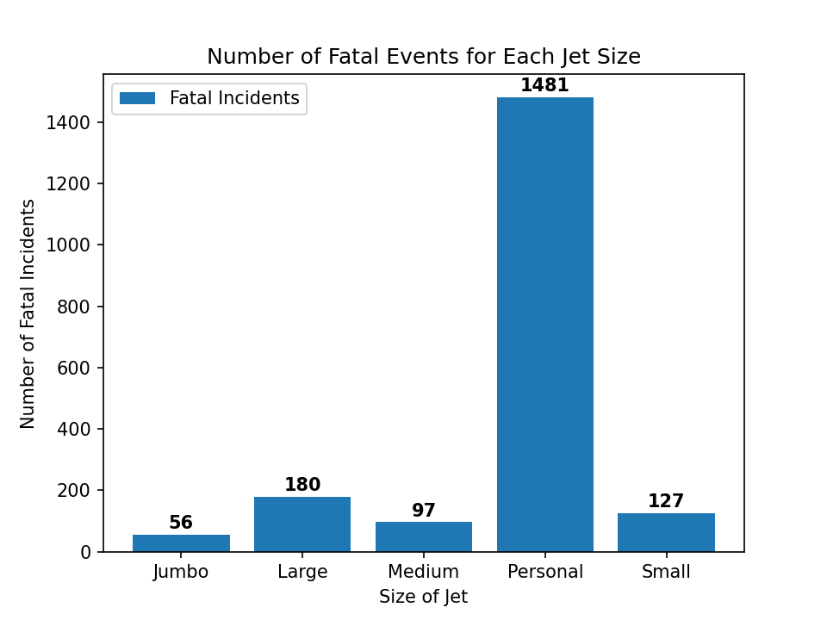
Results: Size of Jet (Passenger Capacity)
Jets can come in all different sizes (passenger capacities).
I have run an analysis to see if certain Jet sizes are more prone to experiencing fatal incidents during their plights.
Personal Jets seem to have a significantly higher fatality rate than all other sizes of jets.
Jumbo Jets have experienced the fewest fatal incidents since 1962.
Personal: <= 10 passengers, Small: 11 <= passengers <= 50, Medium: 51 <= passengers<= 100
Large: 101 <= passengers <= 200, Jumbo: > 200 passengers

Slide 9
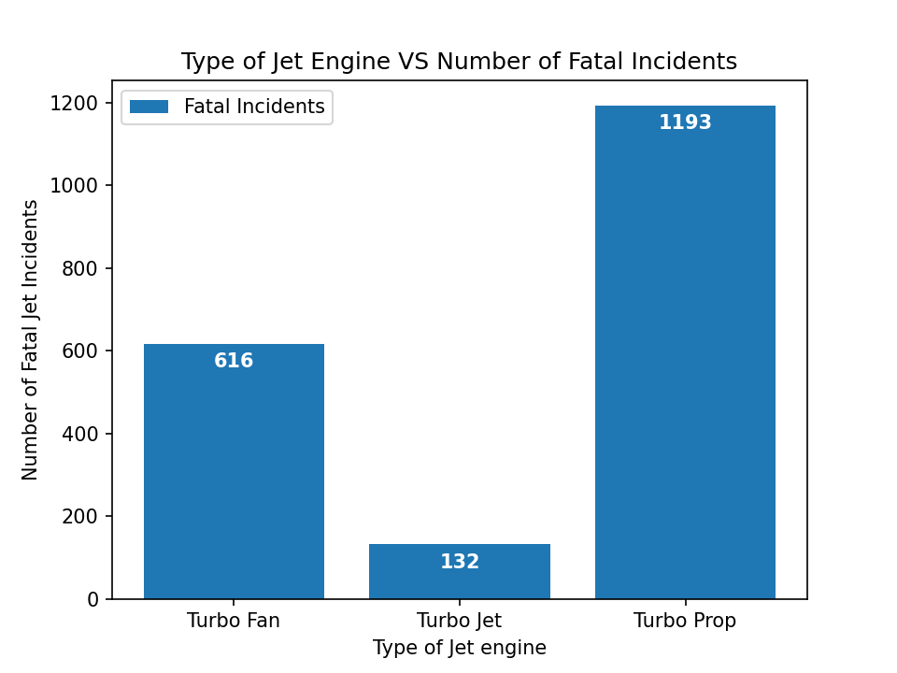
Results: Type of Jet Engine
Different types of Jets utilize different types of engines to propel themselves.
I have run an analysis to see if there is a type of jet engine that has experienced fewer fatal incidents than the other options.
Jets with Turbo Jet Engines have experienced the fewest fatal incidents compared to Jets with other engine types.

Slide 10
Conclusions
Invest in Jets that operate in the Northeast Region of the USA.
Invest in Jet operations with medium commercial passenger carrying capacities.
Invest in Jets that utilize Turbo Jet Engines as a method of propulsion.
This allows us to break into the market with a minimized risk, while entering at a lower price point. With this, we can expand faster to the rest of the country and with additional types of jets once we have solidified our place in the market and gained customer confidence.

Slide 11
Next Steps
Next Steps (Potential Further Analyses)
Jet Improvement Analysis: Which Jets have improved the most over the years and now have a smaller chance of experiencing a fatal incident?
Flight Purpose Analysis: This model could display which types of flights are more prone to experiencing fatal incidents.
Risk Predictor Model: Given details about a potential flight, this model could help predict the level of incident severity a flight could result in.

Slide 12

Thank you!
Email: A.J.Reusche@gmail.com
Github: https://github.com/AndrewReusche
LinkedIn: https://www.linkedin.com/in/andrew-reusche-1397bb311/

